Slide 1
LEAP 2018-19
4TH GRADE

Slide 2
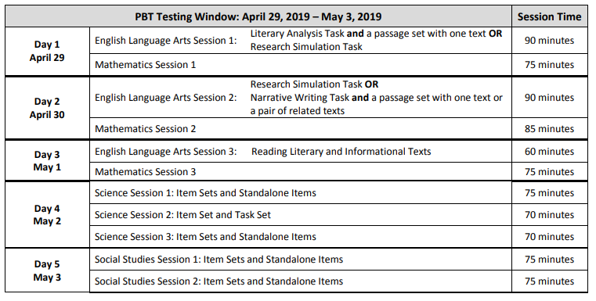
DATES: April 29-May 3, 2019
Test Administration Schedule:

Slide 3
Math
The LEAP mathematics assessment contains a total of 62 points. The table below shows the breakdown of task types and point values.
Test Session | Type I-Conceptual understanding, Fluency, and application (points) | Type II-constructed response (arguments and critiques) (points) | Type III- constructed response (modeling and application) (points) | Total points
Session 1: | 14 | 4 | 3 | 21
Session 2: | 14 | 3 | 3 | 20
Session 3: | 12 | 3 | 6 | 21

Slide 4
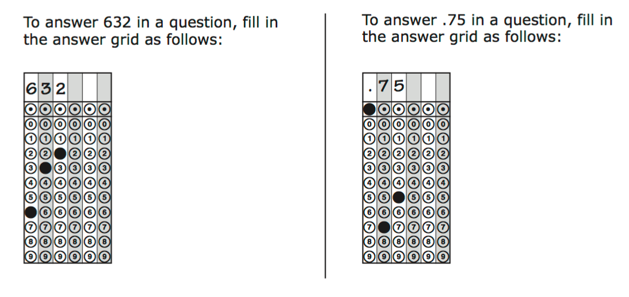
Question Formats:
Multiple choice
Multi-select
Answer Grids
Constructed response

Slide 5
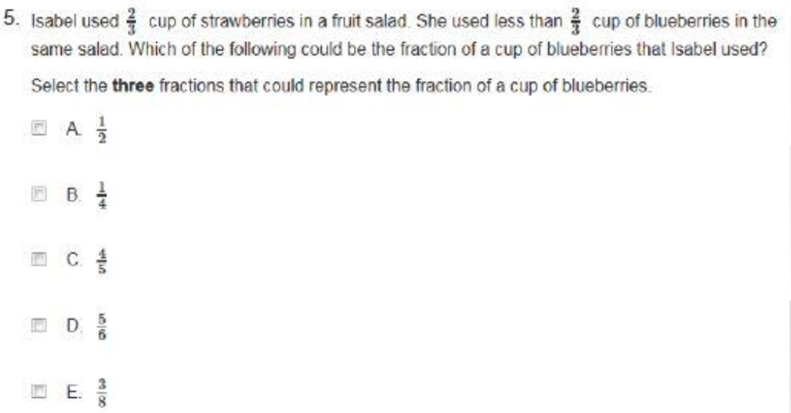
Type I- tasks assess concepts, skills and procedures.

Slide 6
Type II-tasks assess ability to express mathematical reasoning.

Slide 7
Type III-tasks assess modeling and applications.

Slide 9
ELA

Slide 10
ELA Breakdown:

Slide 11
ELA TASKS

Slide 12
Evidence Based selected response – Part A

Slide 13
Evidence Based selected response – Part b

Slide 14
Prose Constructed Response

Slide 15
Writing task for Narrative

Slide 16
Informational Text Set

Slide 17
Science

Slide 18
Science breakdown

Slide 19
Sample items

Slide 20
Sample Items

Slide 21
Sample Items

Slide 23
Sample Items

Slide 24
Sample Items

Slide 26
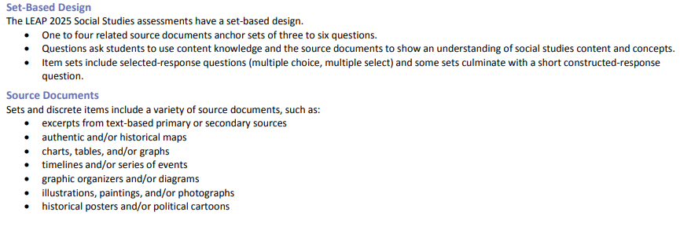
Structure of Social Studies Test

Slide 27
Social studies test design

Slide 28
Sample Item(s)

Slide 29
Continued…

Slide 30
Continued…

Slide 31
Resources:
Study Island
Moby Max
Louisiana Department of Education:
https://www.louisianabelieves.com/resources/library/practice-tests

